Slide 1
Dynamic Programming

Slide 2
Dynamic Programming is a technique in which we use smaller versions of a problem to solve a bigger version and we remember the smaller solutions.
DP problems require two properties
Larger Problem can be solved by using smaller problem solutions
When trying to solve the smaller problems, you see same problems come up multiple times

Slide 3
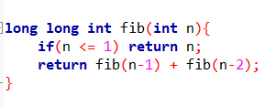
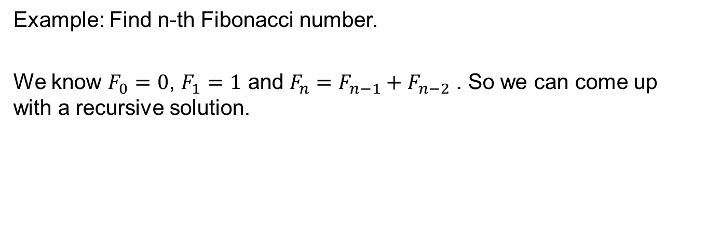
Example: Find n-th Fibonacci number.
We know $F_{0}=0$, $F_{1}=1$ and $F_{n}=F_{n−1}+F_{n−2}$ . So we can come up with a recursive solution.
This is slow, fib(45) takes 7+ seconds on my machine.

Slide 4
F(6)
F(4)
F(5)
F(2)
F(3)
F(3)
F(4)
F(0)
F(1)
F(1)
F(2)
F(1)
F(2)
F(2)
F(3)
F(0)
F(1)
F(0)
F(1)
F(0)
F(1)
F(1)
F(2)
F(0)
F(1)

Slide 5
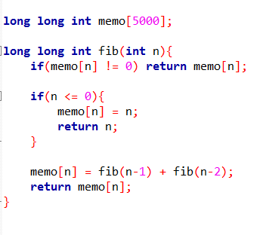
So we use Dynamic Programming (specifically Memoization)
memoization
We never process fib(n) twice and to process fib(n) it takes O(1) time
So time taken O(n) to process all 1, 2, 3 …, n.

Slide 6
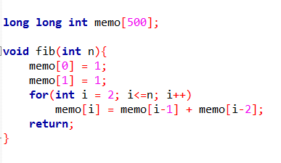
Iterative Dynamic Programming
Also O(n) and more clear.

Slide 7
Recursive DP | Iterative DP
Easier to think | Harder to think
Can call in any order | Need to iterate in a specific order
Slow due to function overhead | Fast as no function required
May not visit all states | Need to visit all state
Cannot maintain states in a DS | Can maintain states in DS

Slide 8
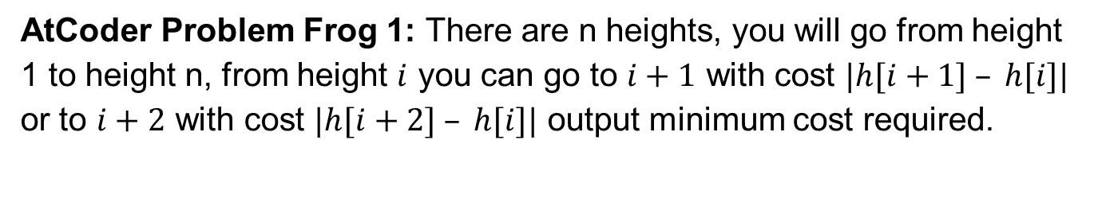
AtCoder Problem Frog 1: There are n heights, you will go from height 1 to height n, from height $i$ you can go to $i+1$ with cost $|h[i+1] – h[i]|$ or to $i+2$ with cost $|h[i+2] – h[i]|$ output minimum cost required.
Some Example Paths:
10 | 5 | 20 | 30 | 15 | 40
5 + 15 + 5 + 25 = 50
10 | 5 | 20 | 30 | 15 | 40
5 + 25 + 10 = 40
10 | 5 | 20 | 30 | 15 | 40
The best path
10 + 10 + 10 = 30

Slide 9
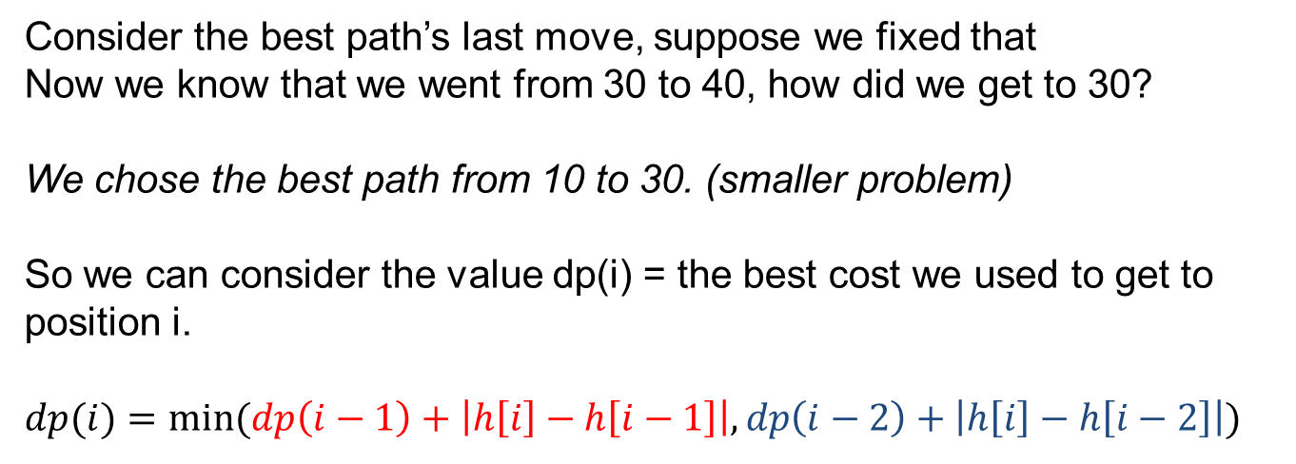
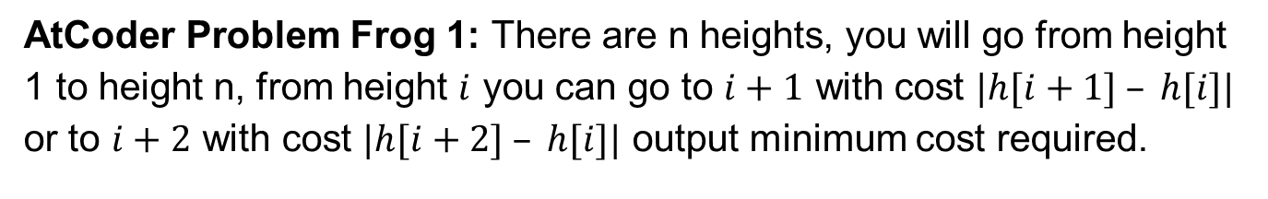
AtCoder Problem Frog 1: There are n heights, you will go from height 1 to height n, from height $i$ you can go to $i+1$ with cost $|h[i+1] – h[i]|$ or to $i+2$ with cost $|h[i+2] – h[i]|$ output minimum cost required.
10 | 5 | 20 | 30 | 15 | 40
10 + 10 + 10 = 50
Consider the best path’s last move, suppose we fixed that
Now we know that we went from 30 to 40, how did we get to 30?
We chose the best path from 10 to 30. (smaller problem)
So we can consider the value dp(i) = the best cost we used to get to position i.
$$dp(i)=min⁡(dp\left(i−1\right)+\left|h\left[i\right]−h\left[i−1\right]\right|, dp\left(i−2\right)+\left|h\left[i\right]−h\left[i−2\right]\right|)$$

Slide 10
Input
10 | 5 | 20 | 30 | 15 | 40
DP table
0 | 5 | 10 | 20 | 15 | 30
This was Bottom Up approach.
There is also Top Down approach.
In this approach we let dp(i) = minimum cost to get to last position from i-th position
DP table for Top Down approach
Input
10 | 5 | 20 | 30 | 15 | 40
DP table
30 | 25 | 20 | 10 | 25 | 0

Slide 11
Sample Problem: you are given an array of numbers, you can choose some numbers and negate them, but you cannot choose two adjacent numbers, what is the maximum sum of the array you can get.
Some Examples:
-10 | 5 | -90 | -30 | 50 | -60
-90 | -5 | -1 | -80 | -90 | -40
-1 | 5 | 1 | 10 | 100 | 1
We can try dp[i] = max sum we can get in numbers upto position i
But it’s easier to think of
dp[i][0] = answer upto i, but i-th number was not negated.
dp[i][1] = answer upto i and i-th number was negated.

Slide 12
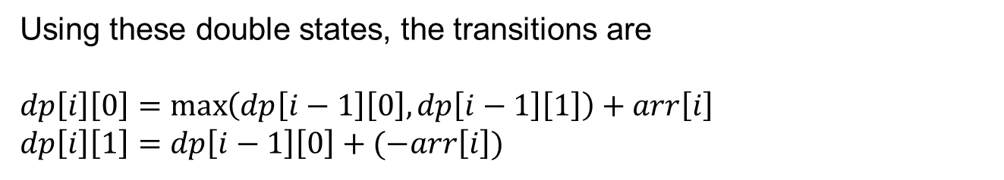
Sample Problem: you are given an array of numbers, you can choose some numbers and negate them, but you cannot choose two adjacent numbers, what is the maximum sum of the array you can get.
Using these double states, the transitions are
$$dp\left[i\right]\left[0\right]=\max\left(dp\left[i−1\right]\left[0\right], dp\left[i−1\right]\left[1\right]\right)+arr\left[i\right]$$
$$dp\left[i\right]\left[1\right]=dp\left[i−1\right]\left[0\right]+(−arr\left[i\right])$$
The final answer is $max⁡(dp\left[n−1\right]\left[0\right], dp\left[n−1\right]\left[1\right])$

Slide 13
Steps to solve a DP problem:
Solve some small samples by trial and error
Determine the states of DP, ask yourself, what really matters? Or what do I need to remember?
Determine the transition of the states
Hard code the base case.
Find the order of iteration on states (for iterative)
Compute final answer (might not always be one state)
* Check if some states are redundant
* Check if transitions can be made faster
* If all states are not visited, recursive might be better.

Slide 14
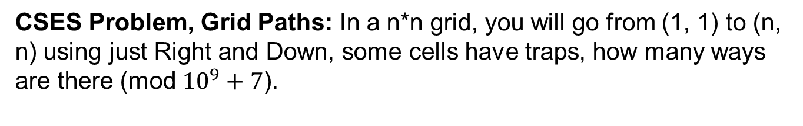
CSES Problem, Grid Paths: In a n*n grid, you will go from (1, 1) to (n, n) using just Right and Down, some cells have traps, how many ways are there (mod ${10}^{9}+7$).
Solution: We define dp[i][j] = count of way to get to (i, j)
. | O | .
. | . | .
. | . | .
1 | 0 | 0
1 | 1 | 1
1 | 2 | 3
Grid
DP table

Slide 15
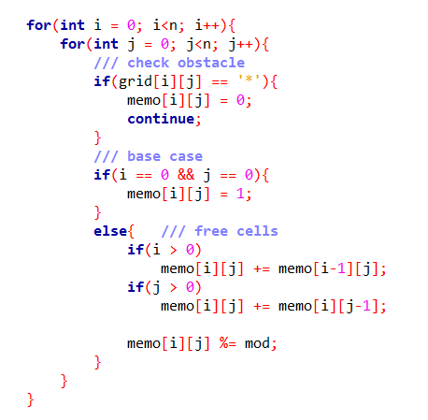
CSES Problem, Grid Paths: In a n*n grid, you will go from (1, 1) to (n, n) using just Right and Down, some cells have traps, how many ways are there (mod ${10}^{9}+7$).

Slide 16
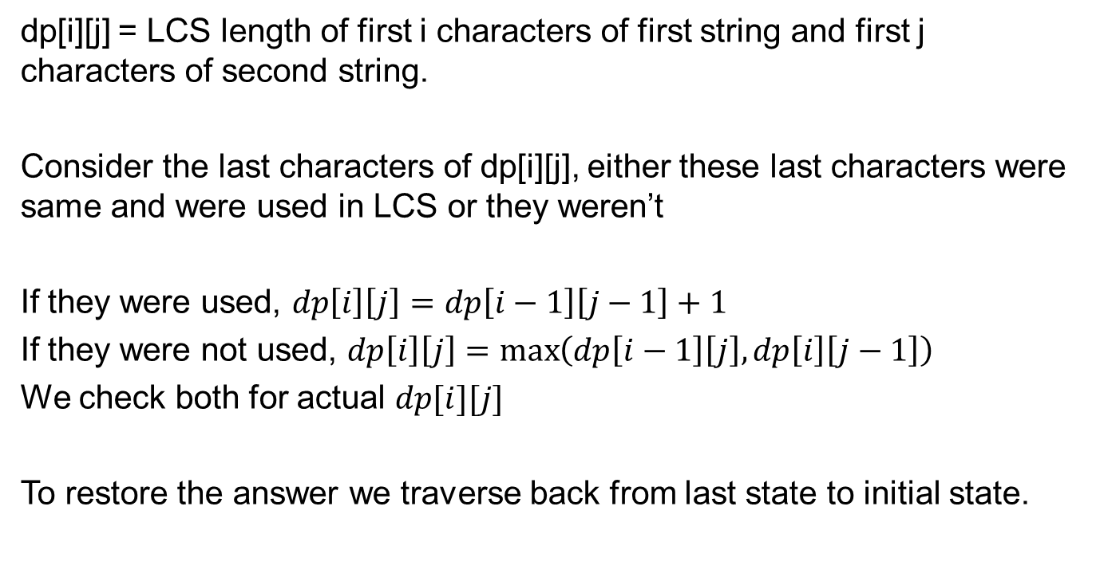
LCS : Given two strings, output their longest common subsequence.
Example: “ABAB” and “BCAB” have LCS “BAB”
dp[i][j] = LCS length of first i characters of first string and first j characters of second string.
Consider the last characters of dp[i][j], either these last characters were same and were used in LCS or they weren’t
If they were used, $dp\left[i\right]\left[j\right]=dp\left[i−1\right]\left[j−1\right]+1$
If they were not used, $dp\left[i\right]\left[j\right]=\max\left(dp\left[i−1\right]\left[j\right], dp\left[i\right]\left[j−1\right]\right)$
We check both for actual $dp[i][j]$
To restore the answer we traverse back from last state to initial state.

Slide 17
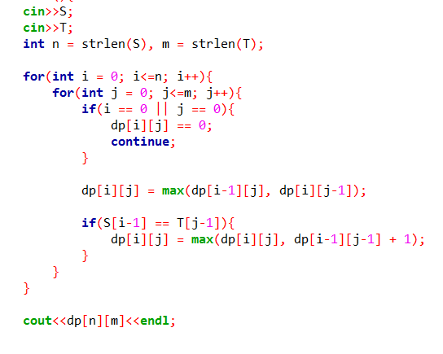
LCS : Given two strings, output their longest common subsequence.

Slide 18
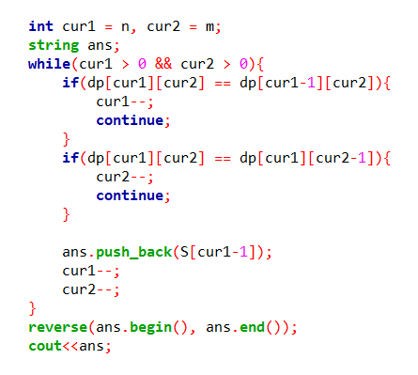
LCS : Given two strings, output their longest common subsequence.
Restoring LCS:

Slide 19
Coin Change Counting: Given some coins, how many ways can you make x ?
There are many versions to this, here are 2 version we’ll solve now:
You count all orders of same sum (2+5+2 is different from 5+2+2)
You count all orders of same sum only once (2+5+2 is same as 2+2+5)
There are also optimization version (minimum count of coin to make x), existence query (can x be made by the coins). There are also versions with frequency for each coin given.

Slide 20
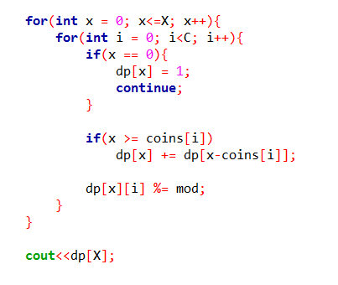
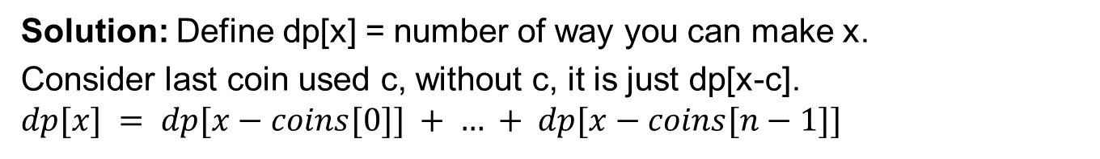
Version 1: You count all orders of same sum (2+5+2 is different from 5+2+2)
Solution: Define dp[x] = number of way you can make x.
Consider last coin used c, without c, it is just dp[x-c].
$$dp[x] = dp[x−coins[0]] + … + dp[x−coins[n−1]]$$

Slide 21
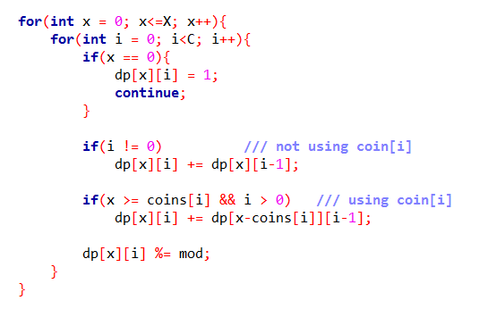
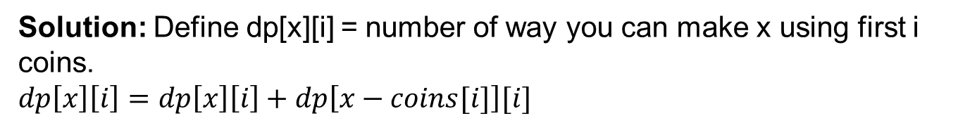
Version 2: You count all orders of same sum only once (2+5+2 is same as 2+2+5)
Solution: Define dp[x][i] = number of way you can make x using first i coins.
$$dp\left[x\right]\left[i\right]=dp\left[x\right]\left[i\right]+dp\left[x−coins[i]\right][i]$$

Slide 22
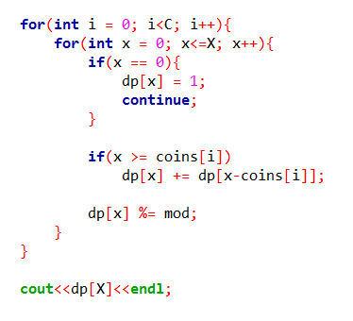
Version 2: You count all orders of same sum only once (2+5+2 is same as 2+2+5)
We can do this using one state too.

Slide 23
Some more classical Problems:
Coin change, but you have to ouput whether x can be made (boolean DP)
Given two array arr and cost and a value x, if you use arr[i], you use cost[i] money, what is minimum cost to get sum exactly x or less than x (Knapsack)
Count how many “ABC” subsequences a string has
Finding Edit Distance of two strings (similar to LCS)
Other Knapsack Problems
You have d choices each day, you have to choose one, but you cannot choose some pair of choices in consecutive days, how many ways to choose

Slide 24
CSES Rectangle Cutting: Given an a×b rectangle, cut it into squares. On each move you can select a rectangle and cut it into two rectangles with integers lengths. What is the minimum possible number of moves?
Example: For a = 3, b = 5, the minimum cut required is 3

Slide 25
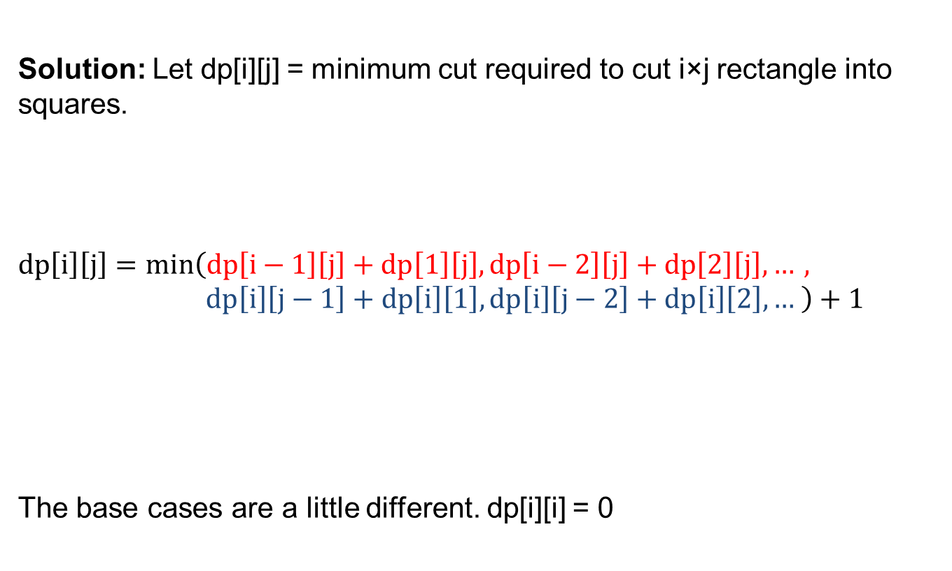
CSES Rectangle Cutting: Given an a×b rectangle, cut it into squares. On each move you can select a rectangle and cut it into two rectangles with integers lengths. What is the minimum possible number of moves?
Solution: Let dp[i][j] = minimum cut required to cut i×j rectangle into squares.
$$dp\left[i\right]\left[j\right]=min\left(dp\left[i−1\right]\left[j\right]+dp\left[1\right]\left[j\right], dp\left[i−2\right]\left[j\right]+dp\left[2\right]\left[j\right], …, dp\left[i\right]\left[j−1\right]+dp\left[i\right]\left[1\right], dp\left[i\right]\left[j−2\right]+dp\left[i\right]\left[2\right], … \right)+1$$
The base cases are a little different. dp[i][i] = 0

Slide 26
Common DP problem properties:
Requiring to maintain some form of sum
Requiring to work with subsequence of an array
Requiring to partition some thing
Work with some path to a goal
Recurrence relation

